Slide 1
Specialties Description
Software Engineering and Management Information Technology Department
Software Engineering and Management Information Technology Department
2017
http://asu.kh.ua/

Slide 2
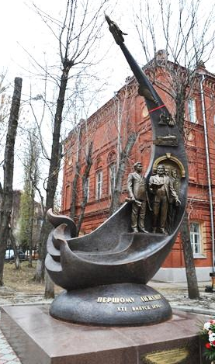
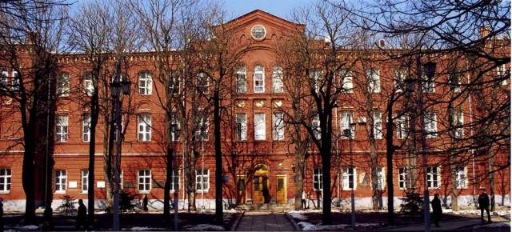
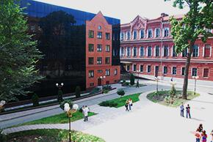
NTU “KhPI”
Software Engineering and Management Information Technology Department
National Technical University “Kharkiv Polytechnic Institute” is the oldest technical university of Ukraine. Computer specialties are more than 50 years old in NTU “KhPI”. NTU “KhPI” is in the top 15 of IT universities in Ukraine.
Faculty of Computer Science and Software Engineering
Faculty was launched in 2000 in response to the urgent needs of scientific and technological progress of modern human community and, in particular, Ukraine’s economic development.

Slide 3
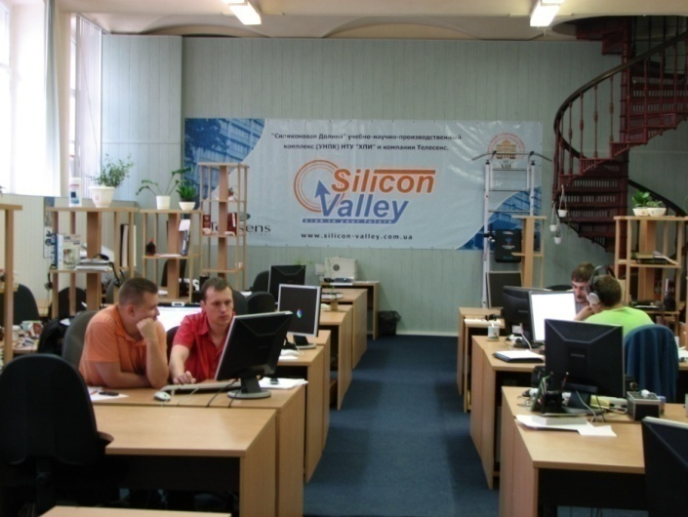
SEMIT Department
Software Engineering and Management Information Technology Department
Was founded by professor A.V. Dabahyan in 1964.
1964 – department: “Automatic Control of Movement”, specialties: “Flight Dynamics and Ballistic Rockets Control”, “Computer-aided Management Systems”
1977 – department: “Computer-aided Management Systems”, specialties: “Computer-aided Management Systems”, “Information Management Systems and Technologies”, and “Computer-aided Systems Software”
2015 – department: “Software Engineering and Management Information Technologies”, specialties: “Computer science” and “Software Engineering”.
Graduates – more than 2000
PhD – more than 100
Doctors of science – more than 20

Slide 4
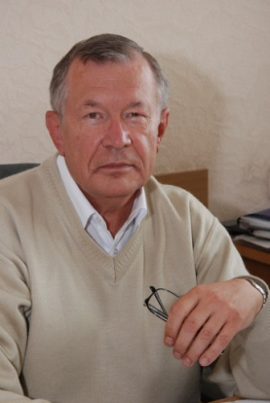
Software Engineering and Management Information Technology Department
Team
Our team combines scholars, researchers, post-docs and assistants who inspire students to achieve their goals.
Head of Department:
Prof. Mykhailo GODLEVSKYI ,Dr. of Tech. Science,
Contacts: e-mail - god_asu@kpi.kharkov.ua, phone/fax +380577076520
Teaching
We provide Education Programs for Bachelors, Masters and PhDs levels in
Computer Science
Software Engineering
Research
Business Data Mining Based on Web-monitoring
Simulation-Based Models for Distributed Logistics
Processing of weak-structured textual data
Quality Improvement of Software Development Process

Slide 5
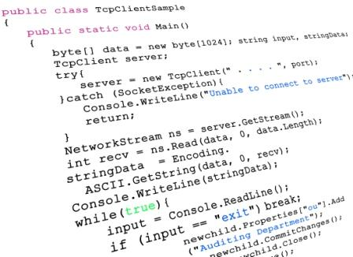
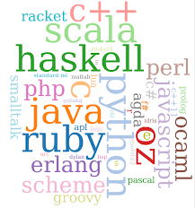
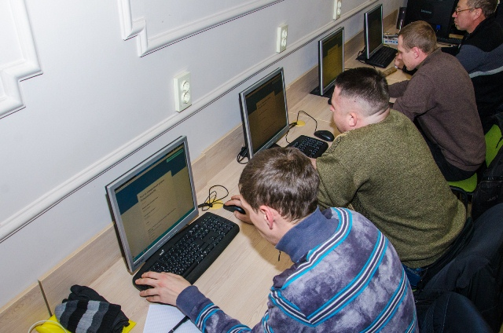
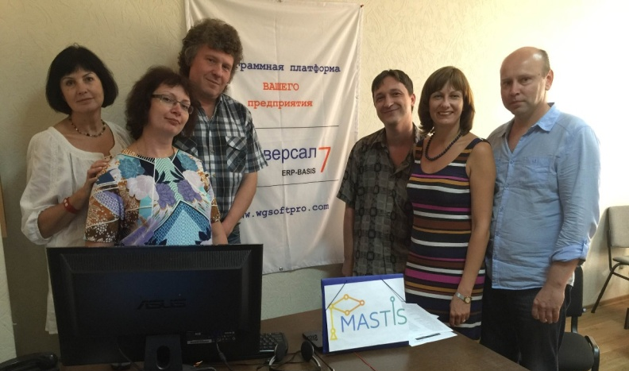
Teaching: Key Points
Software Engineering and Management Information Technology Department
Math and Programming Background
English and language skills
Cooperation with real business

Slide 6
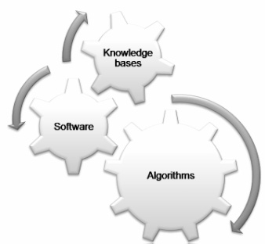
Core subjects
Software Engineering and Management Information Technology Department
Fundamentals | Software Technologies
Calculus | Coding and Programming Languages
Discrete Mathematics | Numerical Methods
Special Sections of Operations Research | Object-Oriented Programming
Probability Theory | Programming (Java, .NET, PHP)
Mathematical Statistics | Computer Networks
Queue Theory | Software Architecture and Design
Theory of Algorithm | Design and Maintenance of Databases
Modeling and Simulation | Mobile Software

Slide 7
Teaching in English
Software Engineering and Management Information Technology Department
English level monitoring (1st year students)
Software Engineering Training (in English)
Language classes
The second foreign language
English for academic purposes

Slide 8
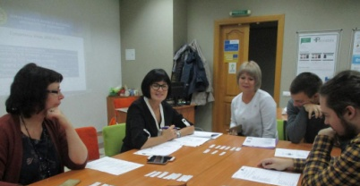
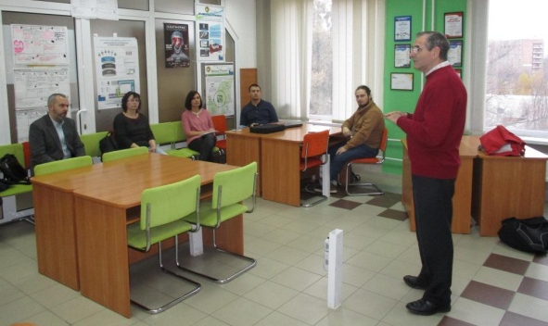
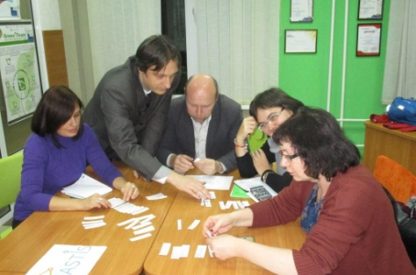
Partnership with Business
Software Engineering and Management Information Technology Department

Slide 9
Amount of Students
Software Engineering and Management Information Technology Department
Bachelor-level Students
Master-level Students

Slide 10
Teaching
Software Engineering and Management Information Technology Department
Bachelor Program in Computer Science
Information and Management Systems and Technologies
Master Programs in Computer Science
Software Project Management
Business Analysis and Management
PhD Program in Computer Science
Information and analytical technologies for monitoring and management of complex systems
Bachelor Program in Software Engineering
Engineering of Software Systems
Master Programs in Software Engineering
Software of Intelligent Systems
Distributed Software Systems and Technologies

Slide 11
Master Program “Intelligent Systems Software”
Software Engineering and Management Information Technology Department
Core courses:
Basics of Intelligent Systems Design;
Theory of Intelligence;
Agent-Oriented Paradigm of Software Systems Development;
Mathematical Fundamentals of Computational Intelligence;
Intelligent Search and Data Analysis;
Prospective Concepts and Technologies of Intelligent Software Systems;
Models and Technologies of Software Security.

Slide 12
Software Engineering and Management Information Technology Department
Master Program “Distributed Software Systems and Technologies”
Core courses:
Architecture and Technologies of Distributed Software Systems;
Models and Software Tools for Distributed Computing;
Cloud Techniques and Applications;
Engineering Design Patterns and Integration of Corporate Applications;
Engineering and Re-engineering in Business Systems;
Models and Techniques of Enterprise IT-infrastructure Management;
Prospective Concepts and Technologies of Distributed Software Systems.

Slide 13
Master Program “Business Analytics”
Software Engineering and Management Information Technology Department
Core courses:
Software Requirements Analysis and Management;
Methods and Models of Management in Modern Business Systems;
Engineering and Re-engineering in Business Systems;
Documentation and Communication in Business Analytics;
Information Systems in Management;
Data Analysis and BI-techniques;
Cloud Computing.

Slide 14
Software Engineering and Management Information Technology Department
Master Program “IT Project Management”
Core courses:
Project Management Standards and Methodologies;
Quality management in IT-projects;
Planning, Implementation and Finalizing of IT Projects;
IT Project Teams Forming and Development;
Risk Management in IT Projects;
Information Technologies in IT Project Management;
Methods of Project Evaluation.

Slide 15
Current International Projects
Software Engineering and Management Information Technology Department
Erasmus+ Programme KA2
Establishing Modern Master-level Studies
in Information Systems
561592-EPP-1-2015-1-FR-EPPKA2-CBHE-JP
Erasmus+ Programme KA1 Higher Education Student and Staff Mobility Inter-institutional agreement between Poznań University of Economics and Business and National Technical University “Kharkiv Polytechnic Institute”
Erasmus+ Programme KA1
Higher Education Student and Staff Mobility Inter-institutional agreement between The Alpen-Adria-Universität Klagenfurt and National Technical University “Kharkiv Polytechnic Institute”

Slide 16
Alumni perspective positions
Software Engineering and Management Information Technology Department
Quality Assurance Engineer;
Software Developer;
Project Manager;
Business Analyst;
Database Administrator.

Slide 17
Software Engineering and Management Information Technology Department
Contacts
Olga CHEREDNICHENKO,
Аssociate professor of SEMIT
department,
National Technical University
"Kharkiv Politechnic Institute“
olha.cherednichenko@gmail.com
Mykhailo GODLEVSKYI,
Doctor of Technical Science, Professor
Head of SEMIT department,
National Technical University
"Kharkiv Politechnic Institute“
god_asu@kpi.kharkov.ua
Tel/fax +38(057)7076520
Cooperation is important for quality!

